Slide 1



GHG Emissions Prediction
By: Spandan Sahai
AICTE Student ID: STU681c8a88811db1746700936

Slide 2

Learning Objectives
Understand the model building of Random Forest Regressor and Linear Regression
Understand hyperparameter tuning
Understand deployment using Streamlit
Understand data preprocessing and feature engineering for machine learning models
Learn how to evaluate model performance using metrics such as Mean Squared Error
Learn how to save and load machine learning models for reuse in production
GOAL
Source :
www.freepik.com/

Slide 3
Tools and Technology used
Programming Language:
Python
Environment:
PyCharm
Streamlit for web application development
Dataset:
Excel (.xlsx) files containing greenhouse gas emission factors and data quality metrics
Libraries and Packages:
Pandas – Data manipulation and analysis
Scikit-learn – Model building, preprocessing, and evaluation
NumPy – Numerical computations
Matplotlib – Data visualization (if applicable)
Joblib – Model serialization and persistence
Deployment Framework:
Streamlit for creating an interactive user interface to collect input and display predictions

Slide 4
Methodology
Data Collection
Gathered greenhouse gas emissions data stored in Excel (.xlsx) files with multiple sheets containing relevant supply chain metrics.
Data Preprocessing
Cleaned and filtered the data to remove missing values and inconsistencies.
Selected relevant features and target variables necessary for model training.
Exploratory Data Analysis (EDA) & Visualization
Analyzed the distribution of features and target variables.
Visualized relationships and correlations among input parameters to inform modeling decisions.
Model Selection
Compared different regression algorithms, including Random Forest Regressor and Linear Regression, to identify the most suitable model for prediction accuracy.
Model Training
Split the data into training and testing subsets.
Scaled the feature data and trained the Random Forest Regressor using the training set.

Slide 5
Methodology (Continued)
Model Evaluation
Assessed model performance using Mean Squared Error to measure prediction accuracy and validate the model on unseen data.
Local Deployment Using Streamlit
Built an interactive Streamlit web application to collect user inputs and display real-time predictions of supply chain emission factors.

Slide 6
Problem Statement:
Real-World Context
Greenhouse gases (GHGs) such as carbon dioxide, methane, and nitrous oxide are major contributors to climate change and global warming.
Environmental and Health Impact
The accumulation of GHGs in the atmosphere leads to rising global temperatures, extreme weather events, and sea-level rise.
GHG emissions also contribute to air pollution, which is linked to serious health issues such as respiratory diseases, cardiovascular problems, and premature death.
Need for Accurate Estimation
Many industries and supply chains lack precise methods to estimate and monitor their emissions.
Inaccurate assessments hinder efforts to reduce carbon footprints and comply with environmental regulations.
Objective
Develop a predictive system that estimates supply chain emission factors accurately, enabling organizations to understand, track, and ultimately mitigate their greenhouse gas emissions.

Slide 7
Solution:
Developed a predictive system to estimate greenhouse gas (GHG) emissions associated with supply chain activities.
This model helps policymakers, engineers, and sustainability managers identify high-emission processes and take targeted action to reduce GHG output over the coming years.
Built and trained a Random Forest Regressor (RFR) model to predict Supply Chain Emission Factors with Margins based on historical data and data quality indicators.
The Random Forest model demonstrated high predictive accuracy and was selected as the preferred approach for deployment.
Integrated the trained model into a Streamlit web application to allow users to input parameters and receive real-time emission predictions.

Slide 8
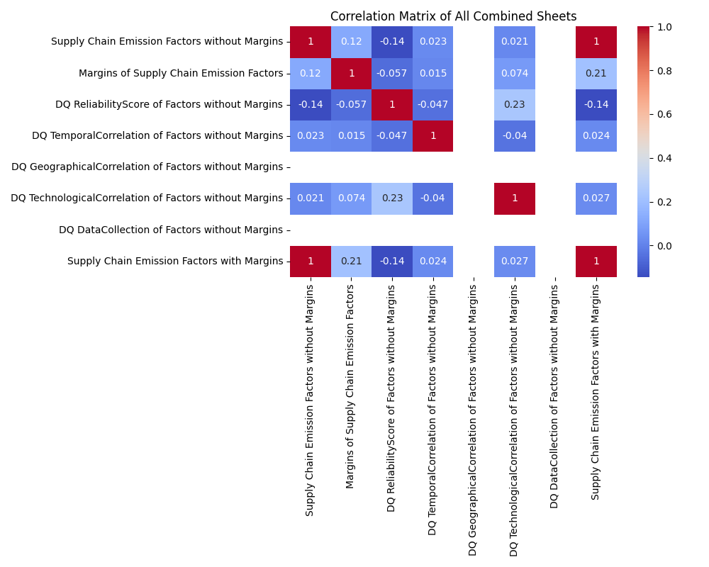
Screenshot of Output:
EDA:

Slide 9
Screenshot of Output:
Model:
User Inputs
Feature Scaling (Standard Scaler)
Random Forest Regressor Model
Predicted Emission Factor

Slide 10
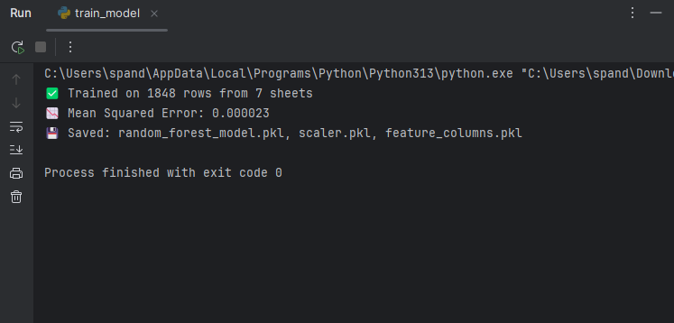
Screenshot of Output:
Evaluation:

Slide 11
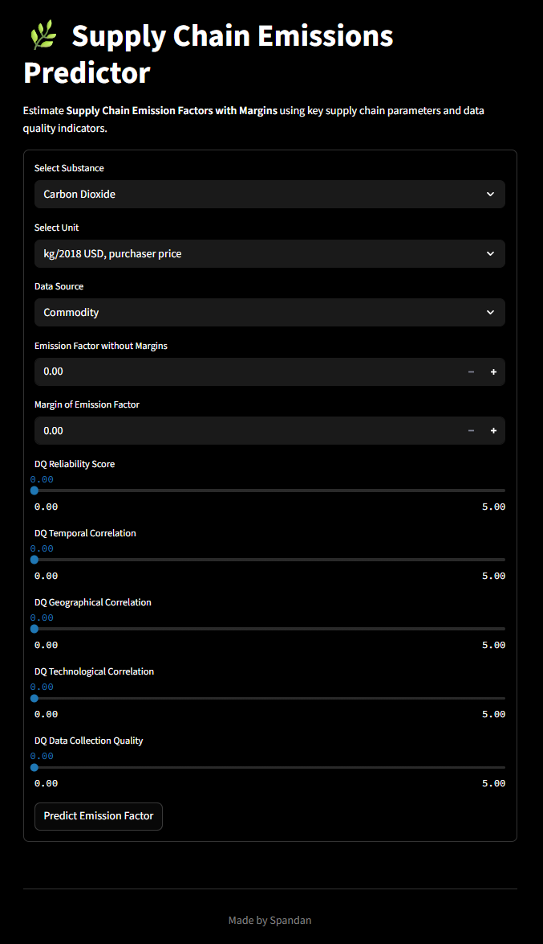
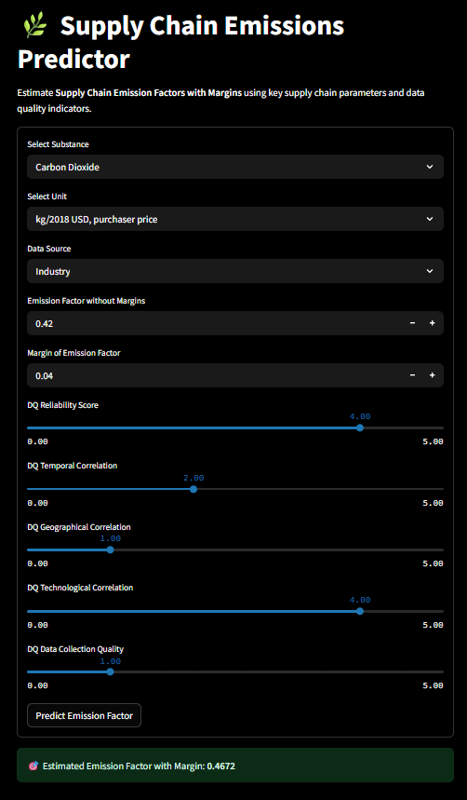
Screenshot of Output:
Deployment:

Slide 12
Conclusion:
Project Summary:
Developed a machine learning model to predict greenhouse gas emissions from supply chain data.
Collected and preprocessed Excel-based datasets containing emission factors and data quality metrics.
Trained a Random Forest Regressor to achieve accurate predictions of supply chain emission factors.
Deployed the model using a Streamlit web application for interactive user input and real-time inference.
Provided a practical tool to help policymakers and engineers monitor and reduce GHG emissions.
Future Scope:
Explore and train a Linear Regression model as a simpler baseline for comparison.
Incorporate additional historical and real-time datasets to improve model robustness and generalization.
Collect higher-quality, more granular data to further enhance prediction accuracy.
Extend the application to forecast emissions over multiple years or simulate the impact of mitigation strategies.
GitHub Link: https://github.com/Warmachine019/AICTE-Internship/

